Slide 1
WoT Web Presence

Slide 2
Status quo
3 different “official” websites and/or entry points
https://www.w3.org/WoT/
https://www.w3.org/WoT/IG/
https://www.w3.org/WoT/WG/
Others sites
Wikipeda (out-dated also)
Community Group: https://www.w3.org/community/wot/
Various Github Projects
Implementations such as http://www.thingweb.io for node-wot

Slide 3
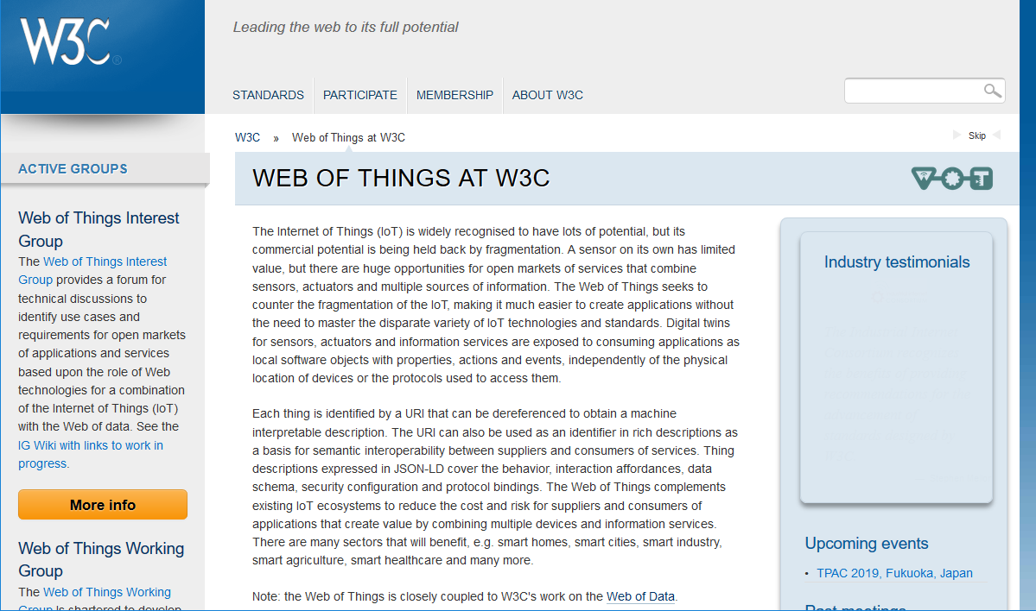

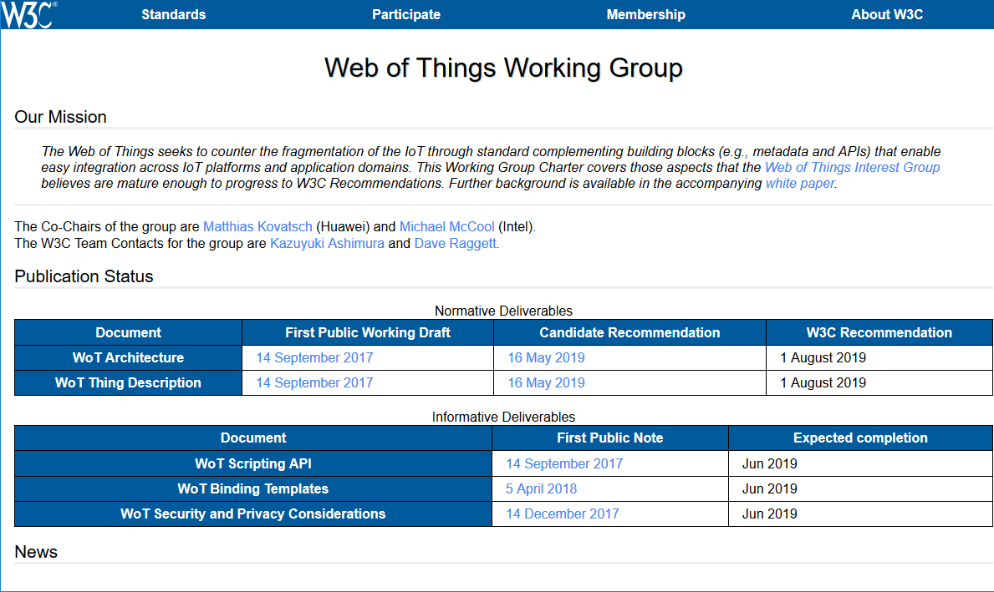

Slide 4
Issues with current Web Presence
„our“ main websites
do all use a different layout and aren‘t nicely linked across each other
are out-of-date
Do not really look very modern
For “other” websites such as Github we can follow best practices such as
README.md with links pointing to our website
…
What else?

Slide 5
„Ideal“ Web Presence - Proposal
Official W3C WoT Website(s)
„one“ site containg IG and WG content /WoT/IG/ or /WoT/WG/ urls are simply navigation shortcuts
Modern and stylisch Web presence
Ask for (commercial) help?
Easy to update
E.g., by github.io tooling like we do already for WG page (see https://github.com/w3c/wotwg)
Other Websites
Wikipedia: Update and/or create new „W3C Web of Things“ besides „Web of Things“
Work on best practices for github projects

Slide 6
Next steps - Tasks
Short-term tasks
Who kicks of the work? Who is responsible? W3C Marcom team?
Costs? Are there any costs/sponsors?
What to do? How to do it? Who takes responibility? Who makes (or is allowed to make) the decisions?
Long-term task
Who keeps the information up-to-date (e.g., do we need a “News” section that easily gets out-of-date)

